Slide 1

Experiential Learning
Project Assessment-I
on
“File Encryption/Decryption Tool”
under the course
Python Programming Language (N-PCCCM304P)
Presented By:
MEHZABIN
HABIB CHHAWARE
CM25028
Under the Guidance
of
Ms.Suchita Meshram
Session:2026-27 (ODD )
Department of CSE(AI&ML) B
S. B. JAIN INSTITUTE OF TECHNOLOGY MANAGEMENT AND
RESEARCH,NAGPUR
An Autonomous Institute, Affiliated to RTMNU, Nagpur
S. B. Jain Institute of Technology Management and

Slide 2
Contents:
• Problem statement
• Objectives
• Algorithm
• Flowchart/pseudocode
• Understanding of Python logic
• GitHub account, repository creation, uploading code, meaningful commits, collaboration, individual contribution
S. B. Jain Institute of Technology Management and

Slide 3
1. Problem Statement:
• Important files may contain confidential or sensitive information.
• Storing files in plain text can make their contents accessible to unauthorized users.
• There is a need for a simple method to protect files using encryption.
• The project converts the original file into an unreadable encrypted format.
• A secret key is required to encrypt and decrypt the file.
• Only a user with the correct key should be able to restore the original file.
• The project demonstrates practical implementation of file security and encryption using Python.
S. B. Jain Institute of Technology Management and

Slide 4
2. Objective
• To develop a simple File Encryption and Decryption Tool using Python.
• To protect files from unauthorized access.
• To encrypt the contents of a selected file using a secret key.
• To decrypt the encrypted file using the correct key.
• To ensure that incorrect keys cannot successfully restore the original content
• To understand the practical use of cryptography in Python.
• To implement file handling, encryption, decryption and key management.
S. B. Jain Institute of Technology Management and

Slide 5
3. Algorithm
1. Start the program.
2. Select the required operation: Encryption or Decryption.
3. Enter the file name/path.
4. Generate or load the secret key.
5. Read the contents of the file.
6. For encryption, transform the original data into encrypted data using the key.
7. Save the encrypted data into an output file.
8. For decryption, read the encrypted file and use the correct key to restore the original data.
9. Display the success or error message.
10. Stop the program.
S. B. Jain Institute of Technology Management and

Slide 6
4. Flowchart
START
1. Select Encryption / Decryption
2. Enter File Path
3. Load / Enter Secret Key
4. Read File Data
5. Encrypt / Decrypt Data
6. Save Output & Display Result
END
S. B. Jain Institute of Technology Management and

Slide 7
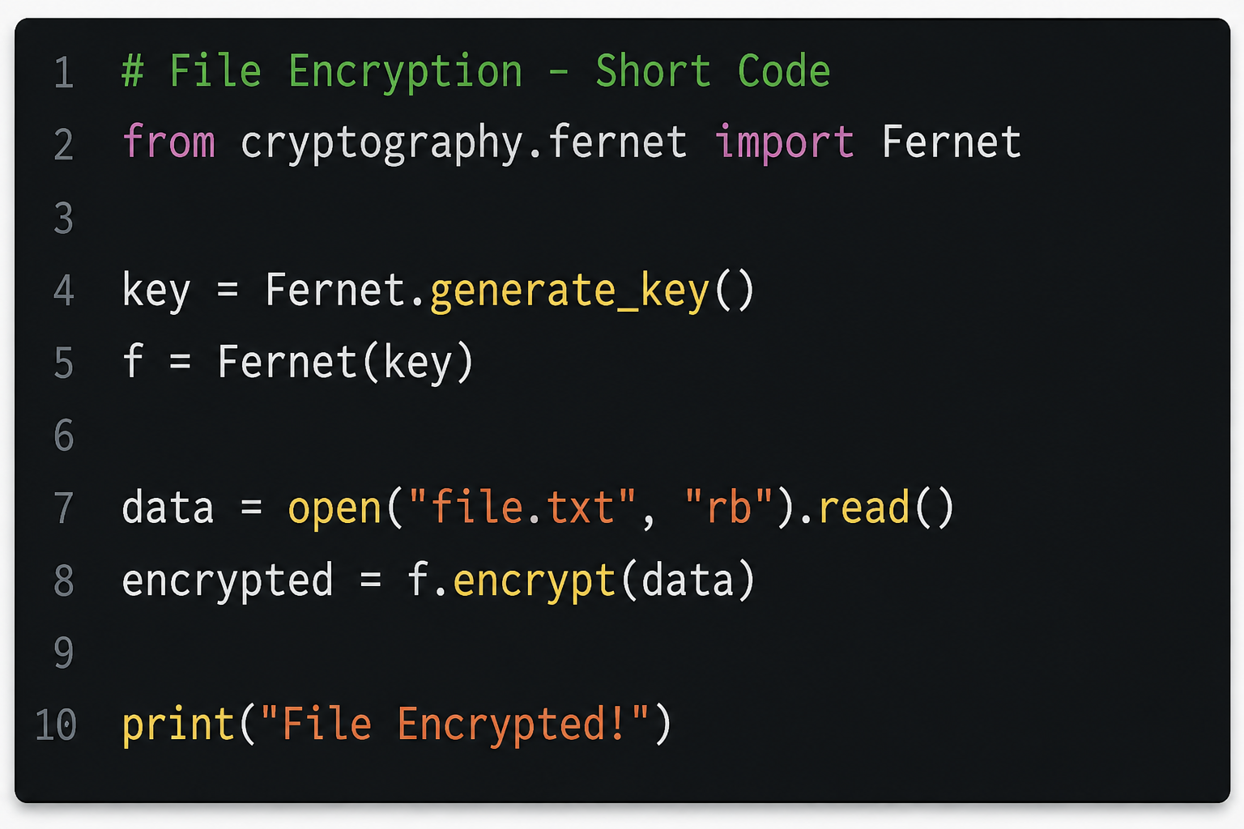
5. Understanding of Python Logic
S. B. Jain Institute of Technology Management and

Slide 8
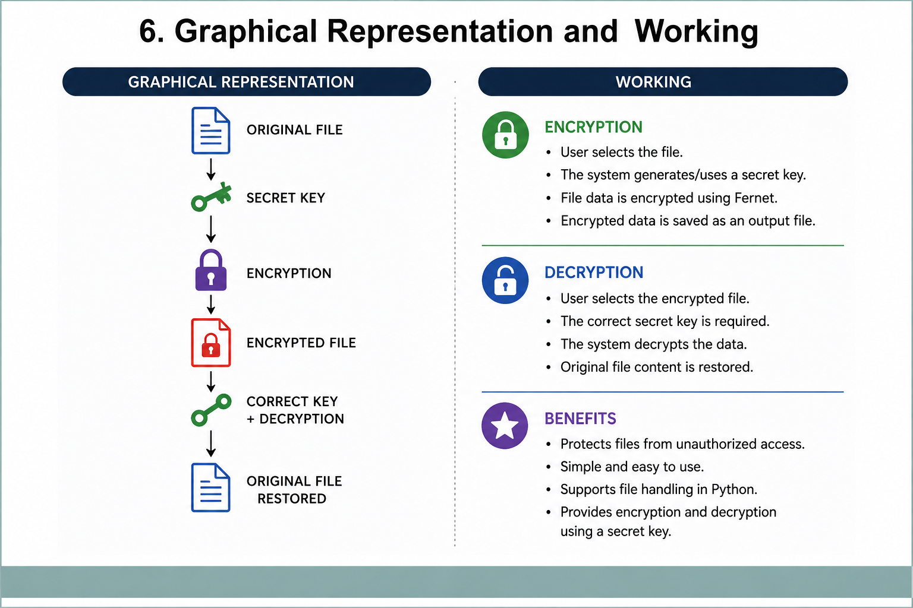

Slide 9
7. GitHub Account, Repository & Collaboration
• Create GitHub Account – Set up a personal GitHub account.
• Create Repository – Create a repository named File Encryption Decryption Tool.
• Upload Code – Upload the Python source code and project files.
• Meaningful Commits – Save changes with clear commit messages.
• Collaboration – Share the repository when working as a team.
• Individual Contribution – Each member contributes and commits their work.
• Track Changes – GitHub helps maintain different versions of the project.
S. B. Jain Institute of Technology Management and

Slide 10
8. Individual contribution
Developed the Python file encryption/decryption logic.
Worked on file handling and secret-key implementation
Tested encryption and decryption.
Prepared project documentation and presentation.

Slide 11
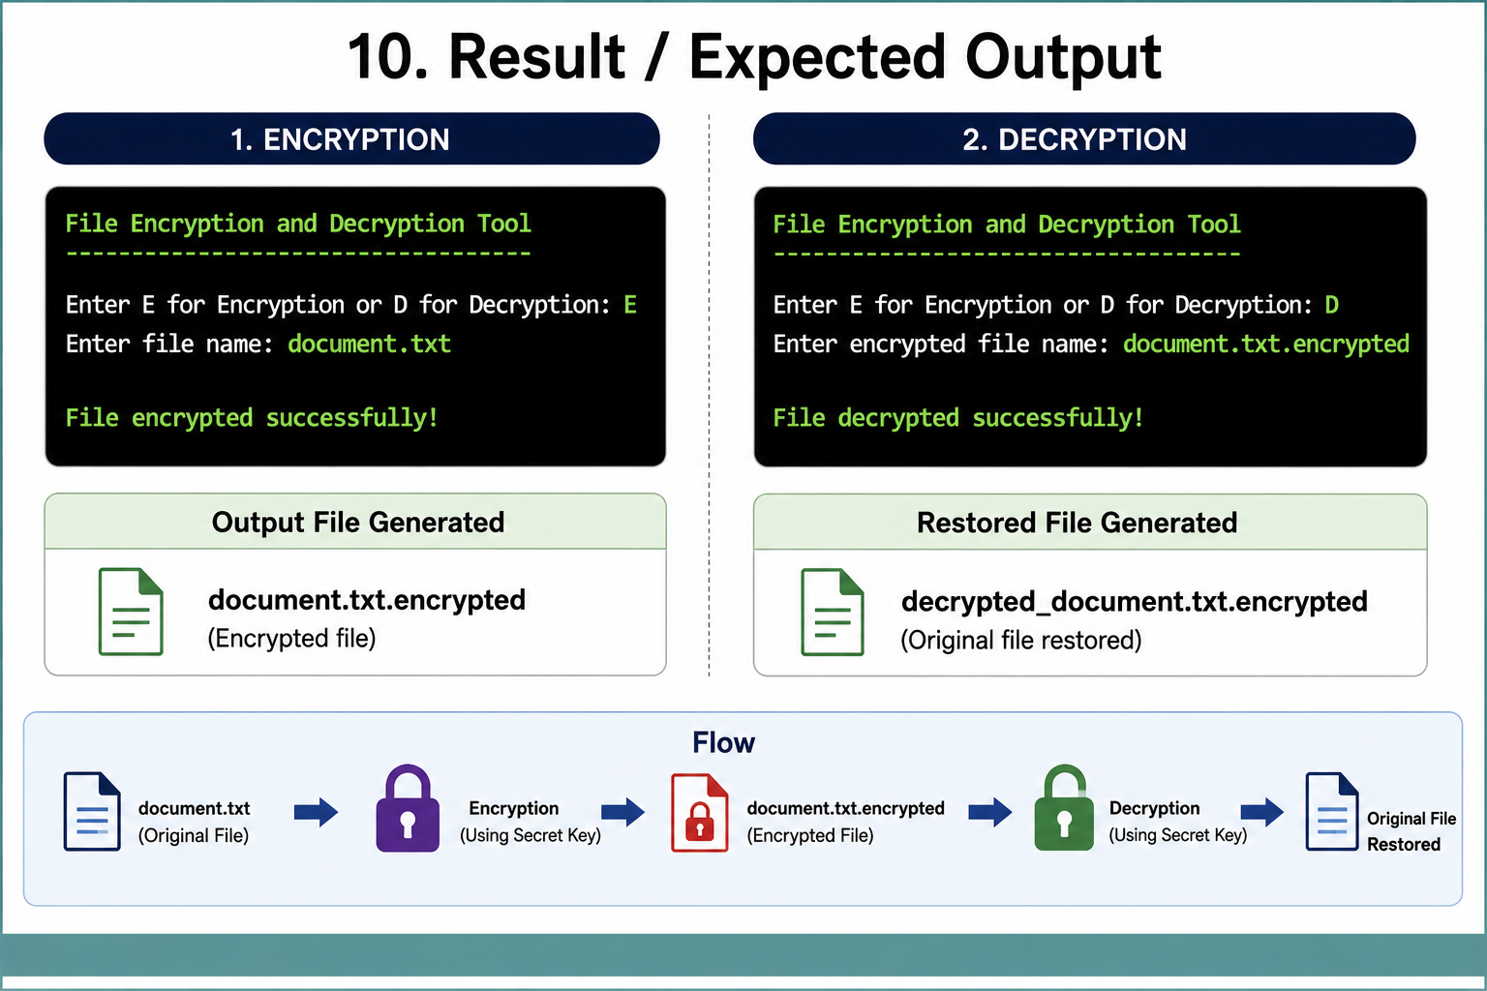
10. Result / Expected Output
Input:
document.txt
Encryption:
Enter E for Encryption or D for Decryption: E
Enter file name: document.txt
File encrypted successfully.
Output:
document.txt.encrypted
Decryption:
Enter E for Encryption or D for Decryption: D
Enter encrypted file name: document.txt.encrypted
File decrypted successfully.
Original File
Encryption
Encrypted File
Decryption
Original Restored
Result: File encryption and decryption are successfully demonstrated using Python.
S. B. Jain Institute of Technology Management and

Slide 12
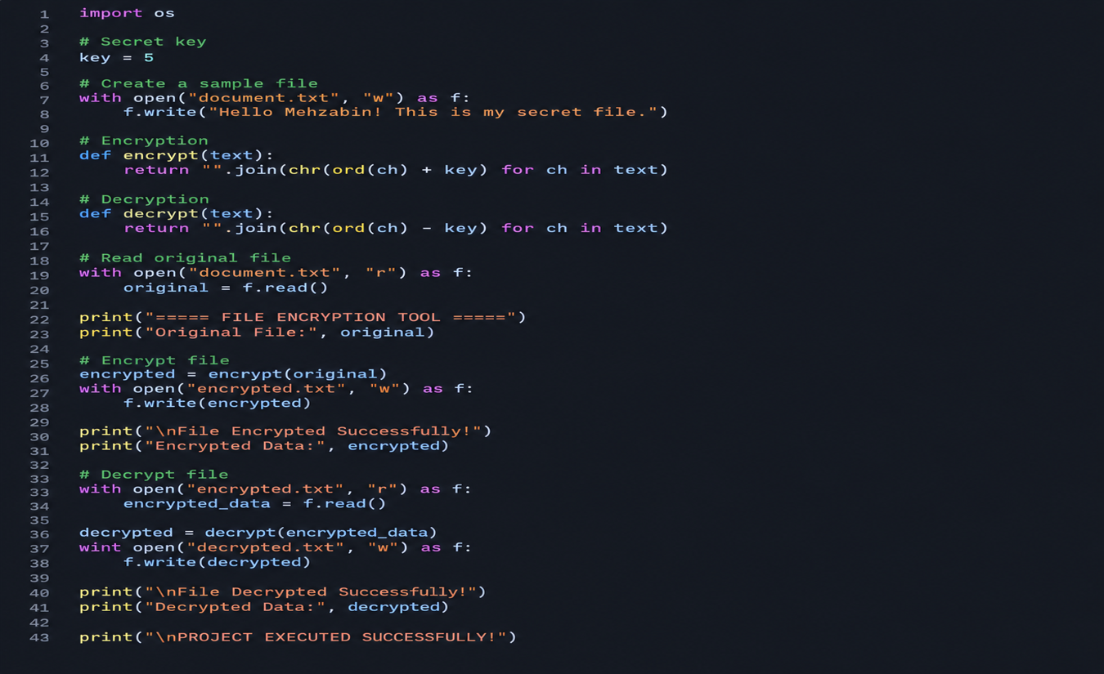
2nd level code

Slide 13
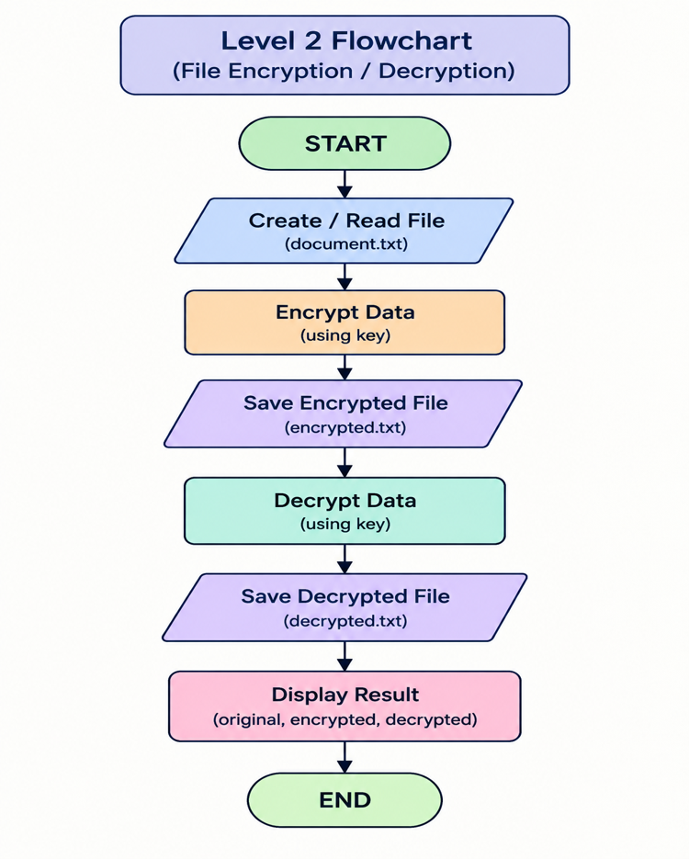
flowchart

Slide 14
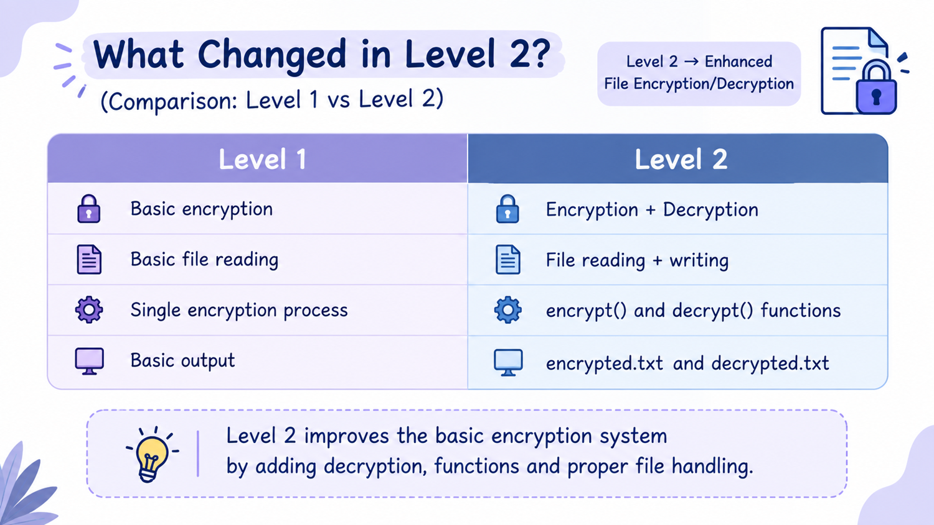
Changes:-

Slide 15
Algorithm:-
Start the program.
Check whether the secret key file exists.
If the key does not exist, generate and save a new secret key.
Load the saved secret key.
Initialize the Fernet encryption object.
Display Encryption and Decryption options.
Ask the user to select an operation and enter the file name.
If the user selects Encryption:
  Read the input file.
  Encrypt the file data using the secret key.
  Save the encrypted data in a new file.
If the user selects Decryption:
  Read the encrypted file.
  Decrypt the data using the secret key.
  Save the decrypted data in a new file.
Display a success message after completion.
Handle missing files, invalid choices, and decryption errors.
Stop the program.

Slide 16
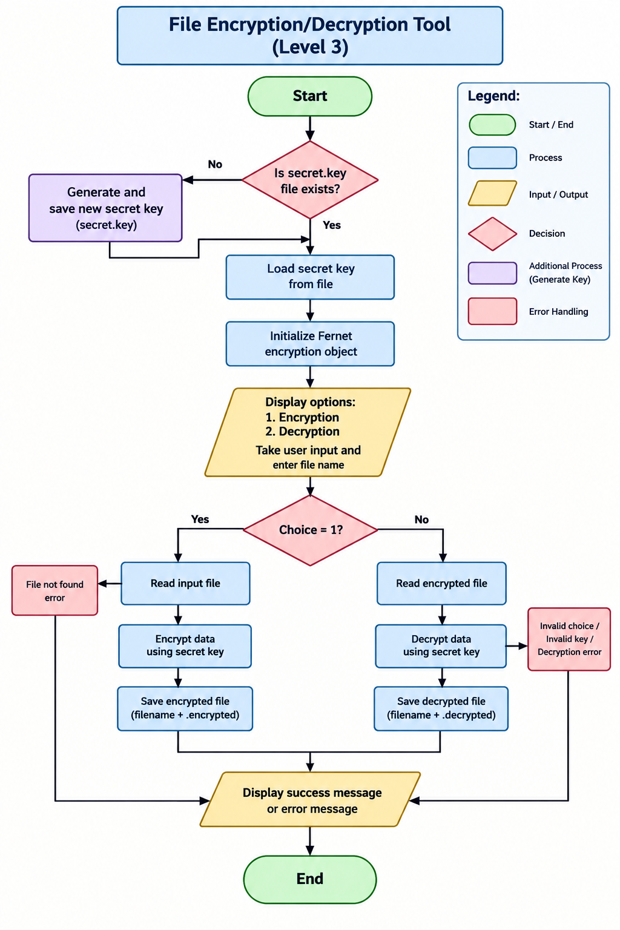
flowchart

Slide 17
conclusion
Successfully developed an improved File Encryption and Decryption Tool using Python.
Implemented automatic secret-key generation and storage.
Added user selection for encryption and decryption operations.
Used the Fernet encryption method to protect file contents.
Implemented separate output files to preserve the original file.
Added error handling for missing files and invalid encrypted data.
Improved understanding of Python functions, file handling, key management, and cryptography.
Future Scope: The project can be extended by adding a graphical user interface, password-based access, and file selection through a browser.

